Slide 1

NYC Dark Kitchen Operations Analysis
Insights from Machine Learning Models and algorithms
Dataset spans 2020-2021, reflecting real business activities in NYC dark kitchens.
Hypothesis on customer behavior, sales forecast and predictive analysis algorithms for month/week band

Slide 2
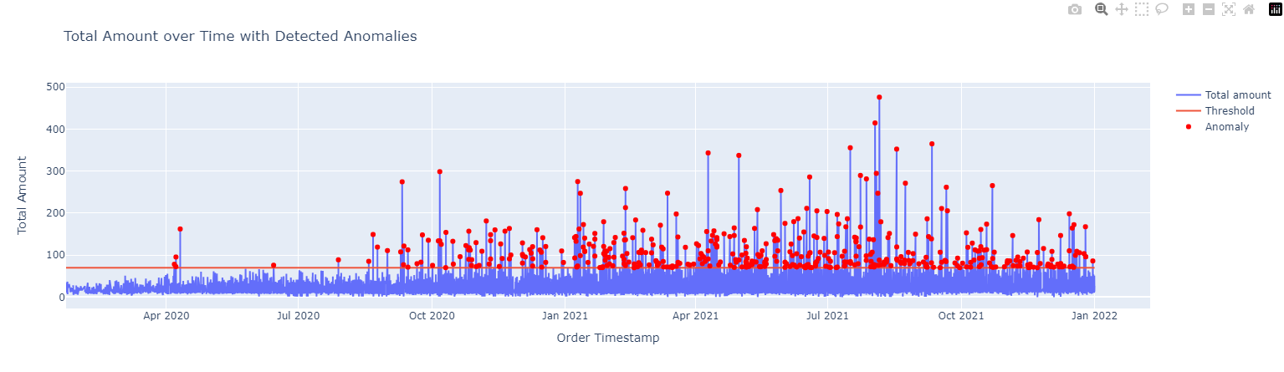
Anomaly Detection in Total Sales
Identified anomalies in total amount over time.
Threshold value set at 70 for anomaly detection.
Graph: Anomalies in Total Sales
My anomaly detection in total sales, using a threshold value of 70 (predefined from historical data), identifies unusual fluctuations in sales data. This analysis is key in pinpointing operational irregularities and guiding data-driven decision-making for optimizing sales performance.

Slide 3
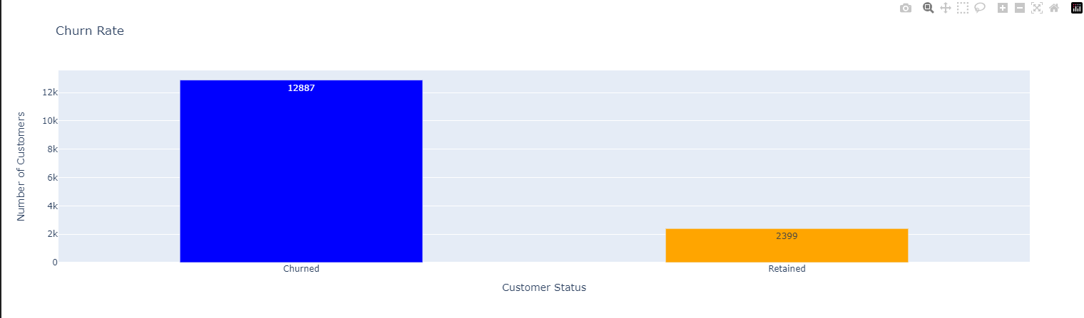
Customer Churn Rate Analysis
Analysis of customer retention and churn over time.
Churn threshold: 60 days without an order.
Graph: Customer Churn Rate
My analysis of customer churn, using a 60-day inactivity threshold, offers valuable insights into customer engagement and loyalty. It helps in identifying at-risk customers early and informs strategies to enhance retention and long-term customer value

Slide 4
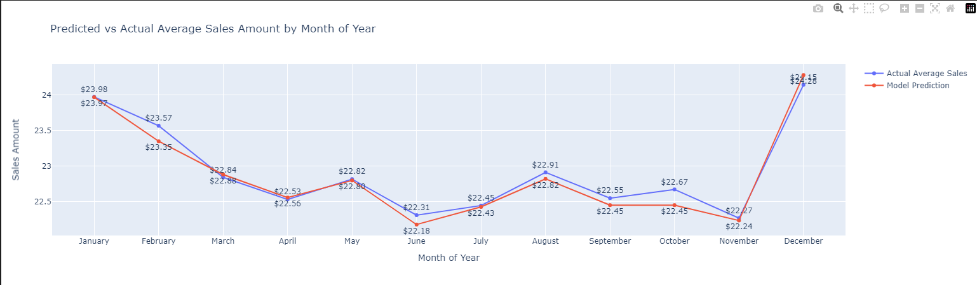
Monthly Sales Predictive Analysis
Gradient Boosting Regressor used for monthly sales prediction.
Comparison between actual sales and predicted values.
Graph: Monthly Sales Predictions
My Monthly Sales Predictive Analysis, leveraging a Gradient Boosting Regressor, effectively forecasts sales trends. This enables proactive business planning and resource allocation, ensuring optimal performance throughout the year. 2 years of average sales on 1-year monthly slot.

Slide 5
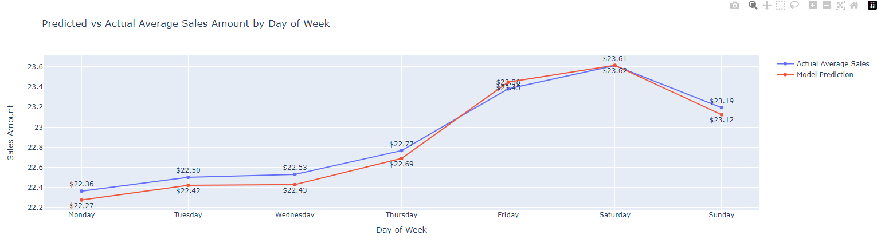
Weekly Sales Predictive Analysis
Analysis of daily sales pattern using Gradient Boosting.
Predictions for sales amount for each day of the week.
Graph: Weekly Sales Predictions
My Weekly Sales Predictive Analysis uses a Gradient Boosting Regressor to forecast sales trends for each day of the week. This approach allows us to anticipate daily sales fluctuations, aiding in efficient resource allocation and strategic planning for peak and off-peak times

Slide 6
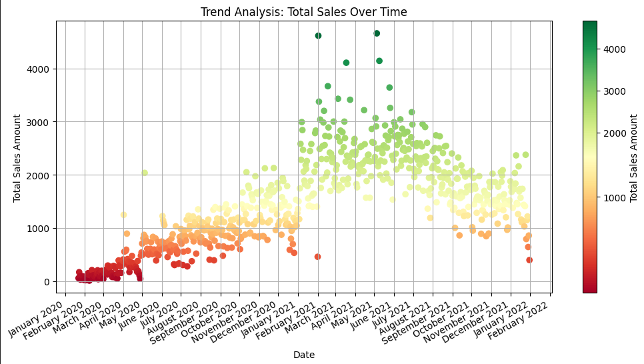
Sales Trend Analysis Over Time
Exploration of daily sales trends.
Use of color gradients to highlight sales intensity.
Graph: Sales Trends
My Weekly Sales Predictive Analysis uses a Gradient Boosting Regressor to forecast sales trends for each day of the week. This approach allows us to anticipate daily sales fluctuations, aiding in efficient resource allocation and strategic planning for peak and off-peak times

Slide 7
Hypotheses and Insights from Analysis
Customer Behavior Insights:
Increased sales during specific days hint at peak customer activity.
Higher churn rates post-holidays suggest a need for targeted re-engagement strategies – need ways to keep them interested.
Sales Trends Observations:
Sales going up in some months due to seasonal demand.
Unexpected high sales might be due to special deals or events.
Operational Efficiency Findings:
Variations in weekly sales trends could reflect operational challenges.
Sudden large orders mean we need to check if we can deliver on time.
Curious Anomalies and Unexplained Trends
Drops in sales at unexpected times need more looking into – App UI problem or customer churn for competitor?
Very big orders could point to new kinds of customers we haven’t focused on (such as party or custom company orders).
Times when sales are low might tell us about customer needs, we’re missing – customer feedback portal needed.
Output
These hypotheses, derived from our data-driven analysis, reveal significant insights into customer behaviors, sales trends, and operational efficiencies. They not only provide clear-cut findings but also uncover curious anomalies and unexplained trends. These insights are invaluable in fine-tuning our business strategies, enhancing customer engagement, and optimizing our operational practices to better align with market dynamics and customer preferences

